Slide 1
KONARK INSTITUTE OF SCIENCE AND TECHNOLOGY
A PRESENTATION ON
IOT based Smart Environment Monitoring System
Department of Computer Science and Engineering
Presented by:
Guided by:
S.K PADHY
SURAJ KUMAR PATTANAIK
Regd-no:1601214128
CSE,7th Sem

Slide 2
Contents:
Introduction.
Hardware requirements
Software requirements
Pictures
How It works.
Design.
Advantages and disadvantages
Future Scope and Conclusion.

Slide 3
Introduction:
This project ‘IOT based Smart Environment Monitoring system’ is a very innovative system which will help to keep tracking the temperature and humidity of Environment and show real time fire alerts.
A Blynk android application is built to show the status to the user, monitoring continuous temperature and humidity. Give fire alert and email to the user.
Status and safety of the environment can be monitored by the user from anywhere in the world.

Slide 4
Hardware Requirement
5V POWER SUPPLY(MOBILE CHARGE/USB PORT)
USB TO MINI USB DATA CABLE
FLAME SENSOR
DHT11 SENSOR
NODE MCU
FEMALE TO FEMALE CONNECTING WIRE
PLY COVER
BUZZER

Slide 5
SOFTWARE REQUIREMENT
ARDUINO IDE
USB TO SERIAL DRIVER
ESP8266 BORAD DRIVER
ESP8266 LIBRARY
EMBEDDED C
SOURCE CODE

Slide 6

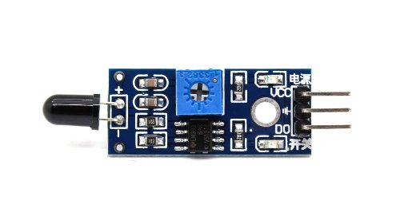
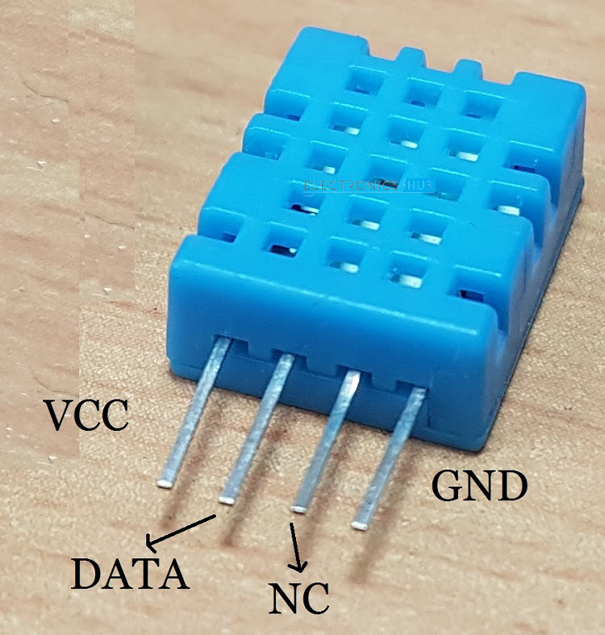
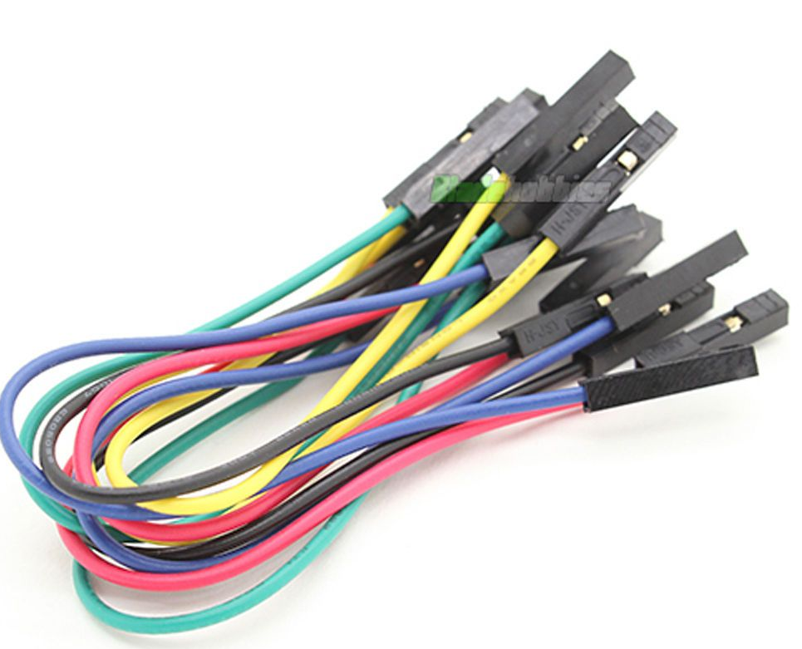
5V POWER SUPPLY FLAME SENSOR
FEMALE TO FEMALE CONNECTING WIRE
DHT11 SENSOR

Slide 7
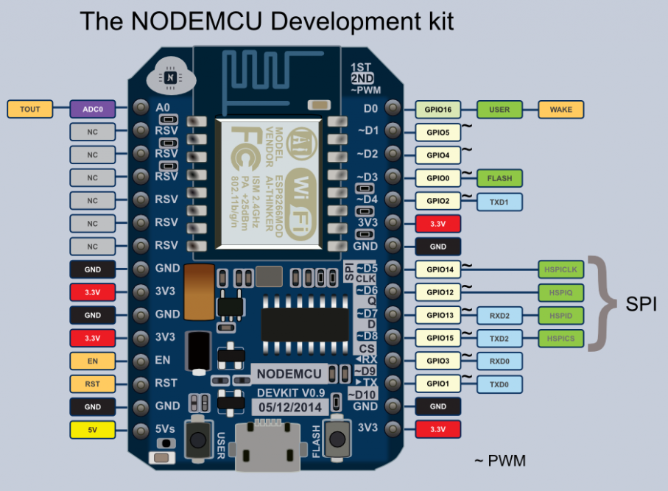
NODE MCU:

Slide 8
How It Works:
With a power supply and after getting connected to an active internet connection The sensors capture the real time data and forward the datas to the Micro Controller Unit through the connecting wires.
The Node Mcu recieves the data and sends it to the Blynk server.
The server checks for the authentication token and sends the data to the corresponding Blynk Mobile application.
Hence we can monitor the live humidity and temparature and can receive fire alerts of any place from anywhere in the world.

Slide 9
Design:
HARDWARE :
1: Flame Sensor:- It has 3 pins. Those are OUTPUT ,GND and Vcc. Connect the OUT pin to the D5 of the Node Mcu (as defined in the source code). GND to gnd and Vcc to 3v3 Of the nodeMcu.
2: DHT11:- Despite of having 4 pins , one of the pin(3rd no) is of no use here. Hence Connect the remaining three pins(i.e: Vin,GND and Input ) with the respective pins of Node Mcu.
3:Buzzer:- Connect the OutPut(+) pin to D7 and Gnd to Gnd of NodeMcu.
SOFTWARE :
In the source code enter the name and password of the local Network and the unique auth token generated by your blynk app at the place of “ssid,pass and auth” respectively and Upload it to the Node Mcu through Arduino IDE.

Slide 10
In the Blynk App:-
Create a new project ,and choose device to ESP8266.Your Authentication token will be sent to your given email address.
Thereafter add two buttons with virtual pins V5 and V6. Name them as HUMIDITY and TEMPARATURE respectively. Add a Terminal with Virtual pin v2,that will show real time alerts.
Add Two more switches for Notification and Email alert.
If the Source Code and Over all Configuration Is perfect , you can see the real time humidity and temp in your Blynk app and can get live fire alerts in your Phone and email.

Slide 11
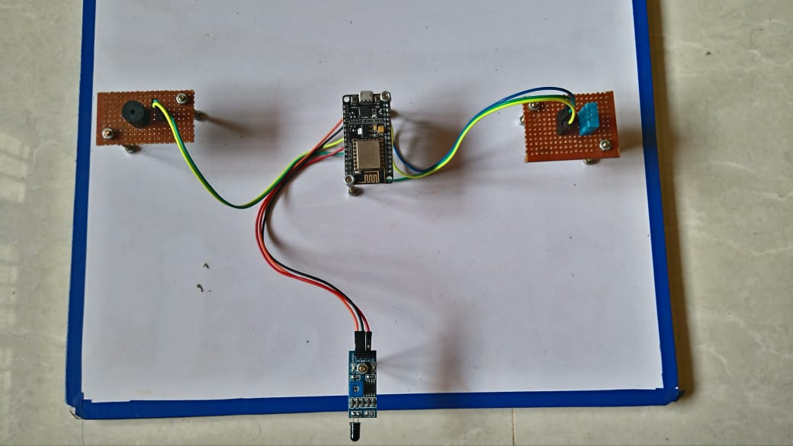
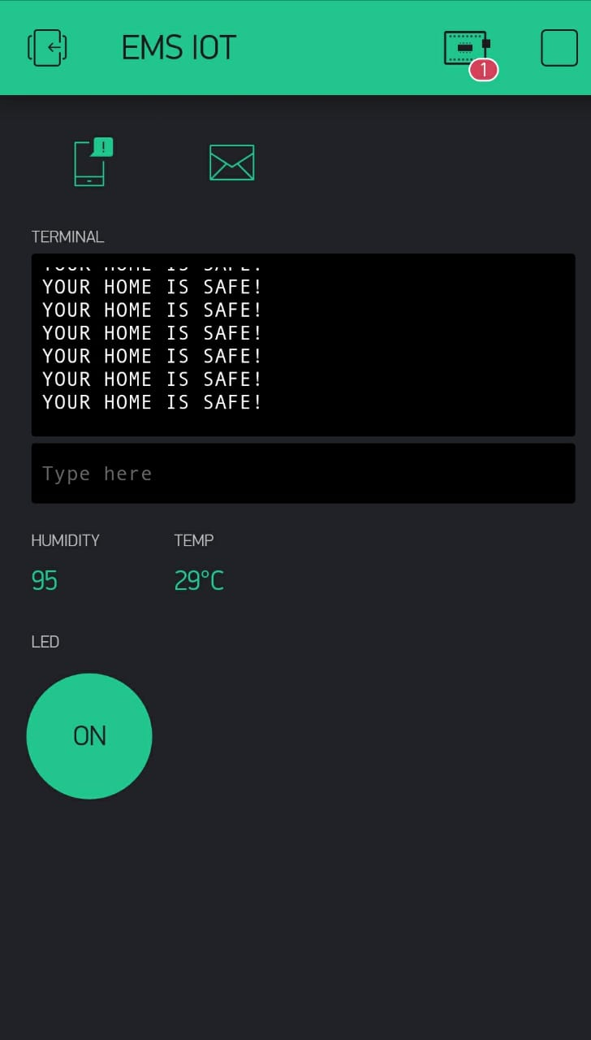
BUZZER
DHT 11
Notify button Email button
NODE MCU
V2
V5
V6
FIRE SENSOR
D0

Slide 12
Advantages
No need to physically check the Environment condition always.
Fire safety can be achieved easily.
Smart way to measure temperature and humidity.
Disadvantages
Always power supply required
Internet connection must be there.

Slide 13
Future scope
Fire catch can be control.
For safety and environment judgment it can be upgrade into higher applicable device.
Conclusion
We designed both the software and hardware
required for this project and tested its working
condition in every angle.

